Slide 1

Tech Flow Space
Blockchain Course -Session 7

Slide 2

ICON
Hyperconnect the world

Slide 3
Ecosystem and History
ICONLOOP = the company, previously Dayli Financial group
loopchain = ICONLOOP’s independently developed blockchain engine. Established and deployed before formation of ICON Foundation
ICON = ICONLOOP’s public blockchain project - Mainnet launch 1/24/2018, Testnet launch 9/14/2018

Slide 4
Why ICON?
ICON is built on Python
DPoC - Delegated Proof of Contribution governance
Built on real world deployments
Support of the Korean government
It is early days for them, but their dev team is top notch and very active

Slide 5
ICON Foundation
ICON protocol development
ICON promotion
ICON community development
ICON roadmap
ICON.Foundation

Slide 6
ICON Foundation
Aims to build a decentralized network that
Allows independent blockchains with their own governances to
Transact with each other without intermediaries
Anyone can create a blockchain project and join the network
Existing communities
Banks
Securities
Insurance
Hospitals
universities,

Slide 7
Vision
A future with faster money remittance and frictionless value exchange of securities, medical records, academic data, insurance fees is within our reach.

Slide 8
Smart Contract - SCORE
Smart Contract on Reliable Environment
Runs on ICON network
Specified by an address on the blockchain
Executed on the ICON Node
Written in Python language
Uploaded as compressed binary data
Runs in sandbox - no file system and network access

Slide 9
ICON Key Concepts
ICX - currency just like ETH in ethereum
Accounts - similar to other systems like ethereum
ICX holding accounts starts with hx prefix e.g hx55c45fa2bf3a31d6eedb63400d0805208aa556d5
Contract/SCORE account address starts with cx e.g cxd568d2b2ba9d33d3a220e5a292c6a9d0c105d2e7
Transactions - Signed data package that changes state on blockchain ( deploying SCORE, transferring ICX, calling a method on a SCORE)
Transaction fees - just like gas in ethereum, prevent resources overuse and infinite loop. Gas -> Step ( computational cost) , Gas Price -> Step price

Slide 10
ICON Key Concepts Contd.
ICON nodes
Peer Nodes - participates in concensus protocol. Uses a variant of proof of stake called Delegated Proof of Contribution (DPoC). Different types of contributor to the ICON network are incentivised to promote and keep the system healthy.
Citizens Node - like infrura in Ethereum, relay txns to nodes and provide api services
Light Client - like SPV wallets in bitcoin. For mobile apps
Governance
Public representative (P-Rep) - full nodes that participates in consensus protocol. Variant of general proof of stake systems.

Slide 11
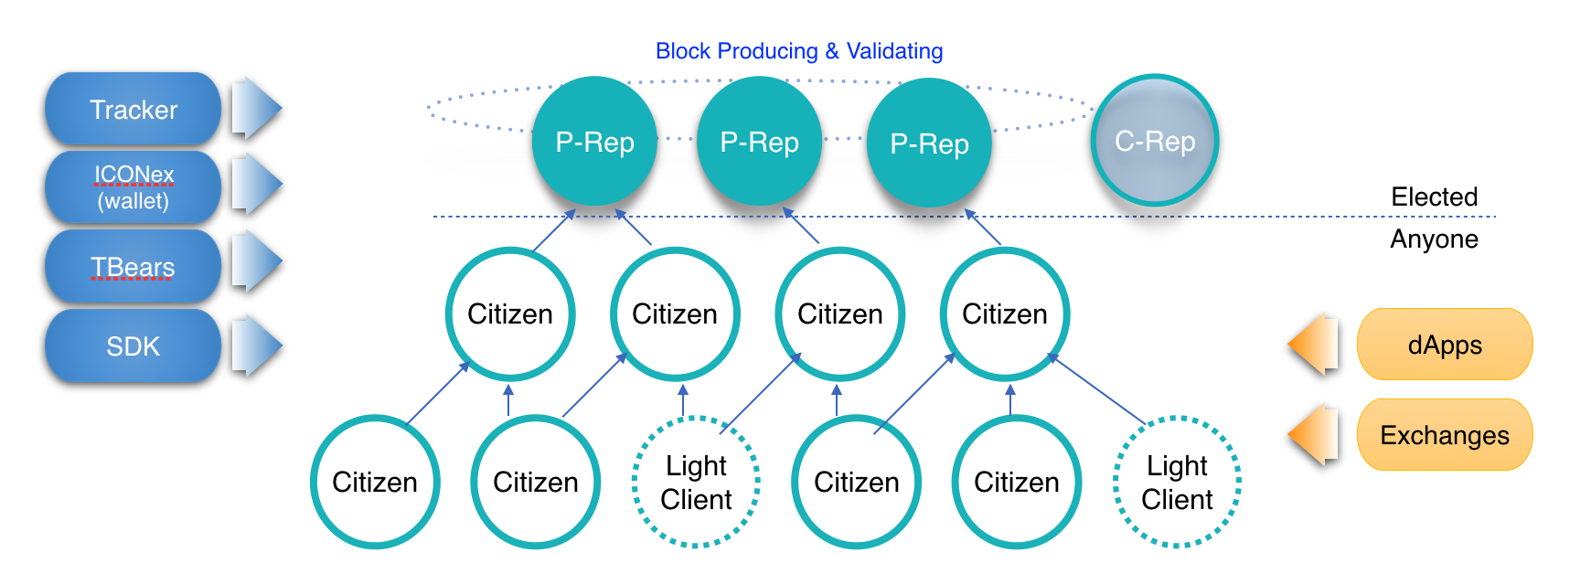
ICON Key Concepts Contd.

Slide 12
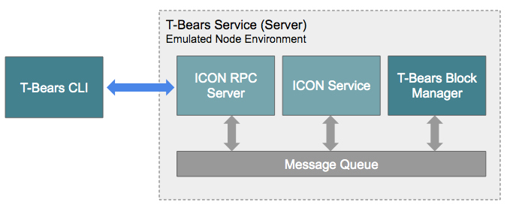
Local Development env.
Just like Truffle and Ganache in Ethereum, ICON has T-Bears - a suite of development tools for SCORE.
T-Bears - local emulated env.

Slide 13
Hello World Example
https://icon-project.github.io/docs/quickstart_p1.html
Let’s follow this instructions to try a hello world score on local tbears
Launch T-Bears

Slide 14
Launch T-Bears
https://hub.docker.com/r/iconloop/tbears
This makes it very easy to work with t-bears
Install t-bears
$ docker run -it --name local-tbears -v ./techflow:/techflow -p 127.0.0.1:9000:9000 iconloop/tbears:mainnet
This should download iconloop/tbears image from docker hub and run it.
It should land you inside the docker container

Slide 15
Test Accounts
Following test account is provided
Address : hxe7af5fcfd8dfc67530a01a0e403882687528dfcb
Password : test1_Account
ICX balance : 0x2961fff8ca4a62327800000

Slide 16
Check Balance of Test Accounts
$root@07dfee84208e:/tbears# tbears balance hxe7af5fcfd8dfc67530a01a0e403882687528dfcb
balance in hex: 0x2961fff8ca4a62327800000
balance in decimal: 800460000000000000000000000
This is the ICX balance on your local instance on account hxe7af5fcfd8dfc67530a01a0e403882687528dfcb

Slide 17
Hello World - Project Initialization
$root@07dfee84208e:/tbears# tbears init hello_world HelloWorld
Initialized tbears successfully
$root@07dfee84208e:/tbears# ls hello_world
hello_world.py __init__.py package.json
tbears init - Initializes a project and creates a score template
hello_world.py is a fully functional score ready to be deployed

Slide 18
DApp Lab- Polling
https://gitlab.com/techflowspace/tfs-blockchain-class-2019/tree/master/session-7

Slide 19
Hello World - Score
from iconservice import * -- sandboxed , cannot import external packages
class HelloWorld(IconScoreBase): -- extend from IconScoreBase - base class
def __init__(self, db: IconScoreDatabase) -> None:
super().__init__(db)
def on_install(self) -> None:
super().on_install()
def on_update(self) -> None: -- allows update of score for certain changes
super().on_update()
@external(readonly=True) -- visibility modifier like in solidity
def hello(self) -> str:
return "Hello"

Slide 20
Deploy Hello World
$root@07dfee84208e:/tbears# tbears deploy hello_world
Send deploy request successfully.
If you want to check SCORE deployed successfully, execute txresult command
transaction hash: 0xc40cbbf2b89cd1e2890132145e6d86ad61835edaca0bcc3a4c34b5cb22b8be28
$root@07dfee84208e:/tbears# tbears txresult 0xc40cbbf2b89cd1e2890132145e6d86ad61835edaca0bcc3a4c34b5cb22b8be28
Transaction result: {
"jsonrpc": "2.0",
"result": { …
"status": "0x1" in txresult indicates that SCORE was successfully deployed.

Slide 21
Interact with Hello World SCORE
To invoke “hello” method on the score -
$root@07dfee84208e:/tbears# tbears call call.json
response : {
"jsonrpc": "2.0",
"result": "Hello",
"id": 1
}

Slide 22
Check Your SCORE (Self Audit)
Go to icon.signal9.io - ICON Contract Support System
Compress the folder containing your SCORE python code.
Upload to the Contract Support System

Slide 23
Example DApps on Mainnet
Event polling
https://tracker.icon.foundation/contract/cxabb4824298da0618c0e30efe394e1f06df825f72
https://pollonchain.app/
Dice roll
https://tracker.icon.foundation/contract/cx6a05658c49d382f90a55f6352d92f9f31a7c8489
http://diceroll.win/

Slide 24
Example DApps on Mainnet Contd.
Number bet
https://tracker.icon.foundation/contract/cx83f9ff5add2b3e0b414e26344ed2be78a85ca416
http://betomatic.win/

Slide 25
Resources
Score

